Slide 1
Techshop
Authors: Móricz János Milán, Lévai Levente József

Slide 2
The problem
Many webshops are overcrowded with iinformation and they are hard to navigate.
The solution
Our webshop is easy to navigate and clean looking.

Slide 3
Functions of the program for users
Registration
Login
Easy checkout
Writing reviews
Search products by name
The user can cancel his order by contacting support

Slide 4
Functions of the program for admins
Login
Create, edit and delete products
Edit and delete users
Delete orders
Create, edit and delete entries
Delete reviews from the product

Slide 5
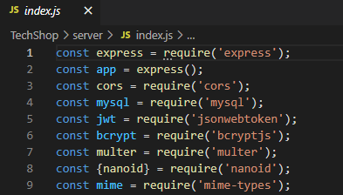

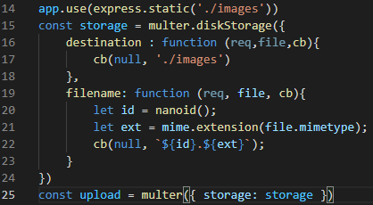

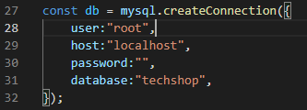
Backend
Modules
Express
Cors
Multer storage with nanoid
Database connection
JWT token authentication
Bcrypt

Slide 6
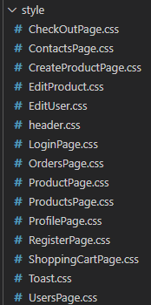
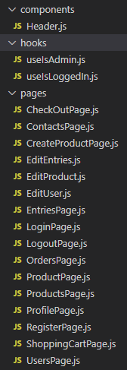
Frontend
React
Bootstrap
CSS
Dependencies
Authentication (roles)

Slide 7
Database
MySQL
Loading data
For all tables
5 tables

Slide 8
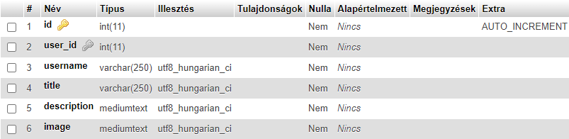
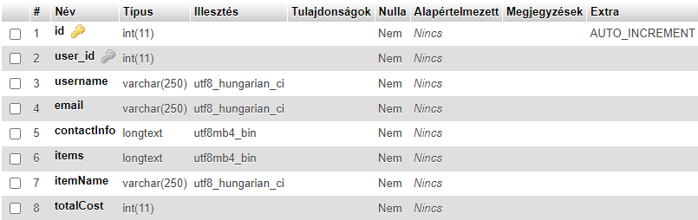
Models
entries
orders

Slide 9
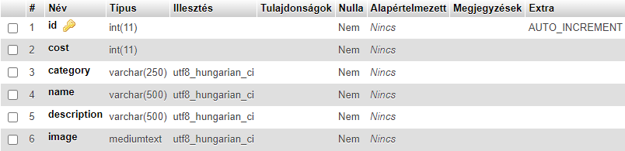
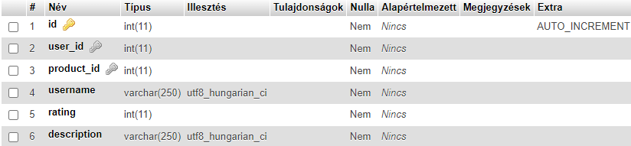
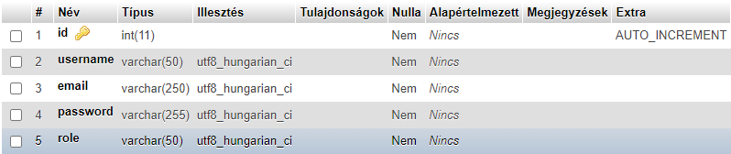
product
reviews
user

Slide 10
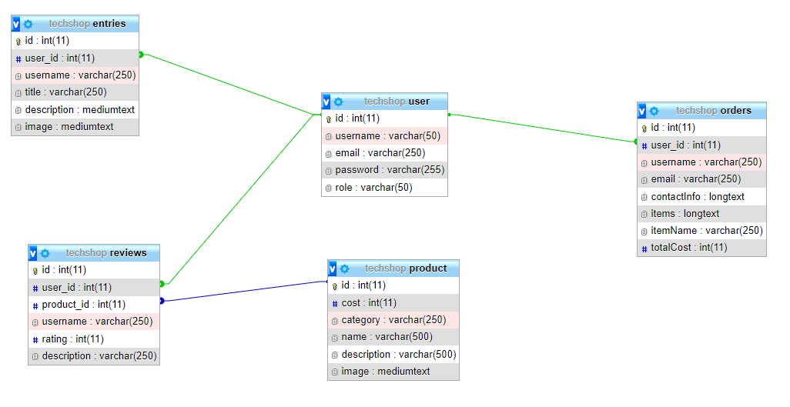
Table connections

Slide 11
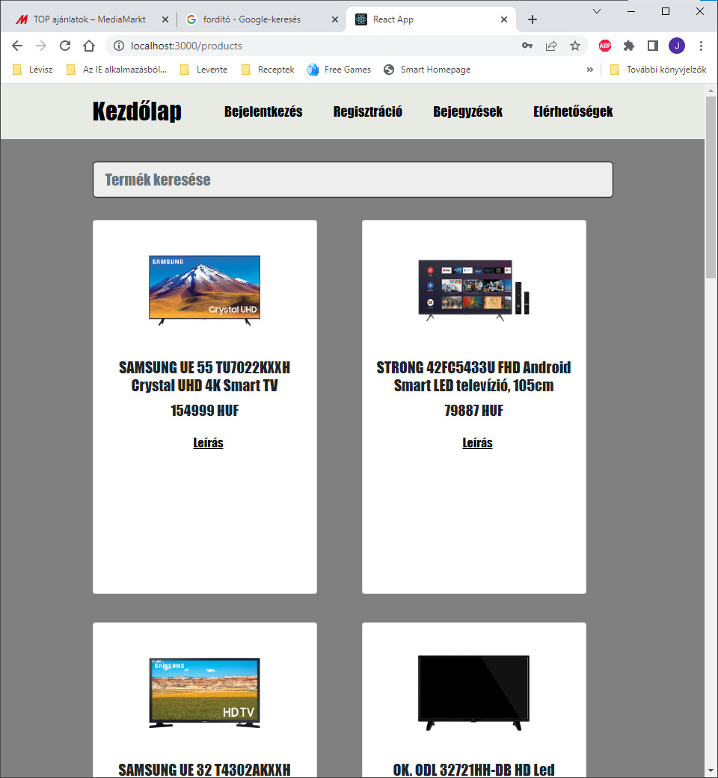
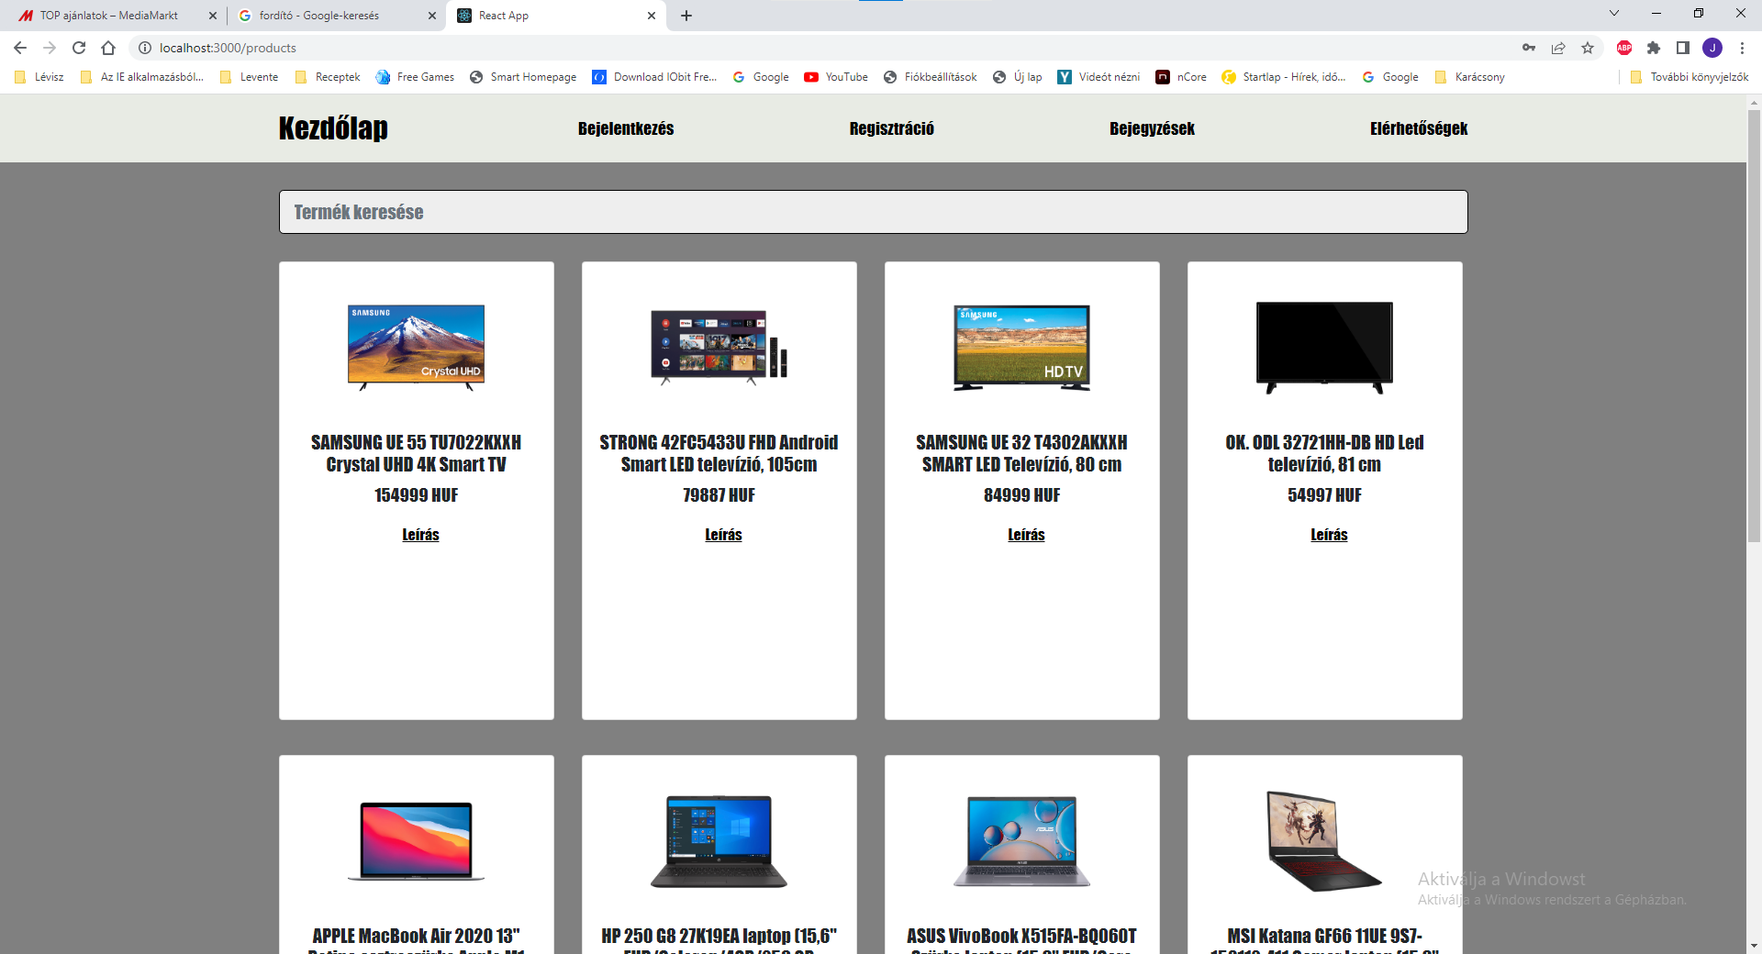
Responsivity

Slide 12
Tests
Frontend
Backend
Postman collection testing for every request.

Slide 13
Teamwork
GitHub
Discord
Facebook
Google Drive
Clean code

Slide 14
Teamwork tasks
Backend, React, Postman testing
Móricz János Milán
React test, database
Lévai Levente

Slide 15
The future
Own domain
Online payment
Chat bot
Expanding the search option
Accessibility options

Slide 16
Thank you for your attention!

